Slide 1
E-commerce
Taught by Yossef Ayman Zedan

Slide 2
Top sectiom
We will give it div with container. Then, section with classes: top d-flex justify-content-md-between flex-md-row flex-column align-items-center.
Now, the number and the shipping need a new d-flex. We will add a new div with d-flex flex-md-row flex-column align-items-center with two col-auto and one col
The after this d-flex of the number and the shipping we will add two dropdowns with new div with class: d-flex align-items-center
We will add two col-auto. The first one will get order-md-first order-last to practice on reordering classes with data-bs-offset="10,10”.
We will give them shadow and edit the Sass of the dropdown

Slide 3
Top section
$dropdown-padding-y: 0rem;
$dropdown-border-color: none;
$dropdown-item-padding-x: 1rem;
$dropdown-item-padding-y: 1rem;
$dropdown-divider-margin-y: 0px;

Slide 4
Navbar
We will take this navbar: https://getbootstrap.com/docs/5.1/components/navbar/#supported-content
The navbar brand will be the image of Nike. We will give mx-auto and text-uppercase to the ul
After the ul, we will add <div class="d-flex align-items-center justify-content-between"> with three items.
The search is for a modal full screen Note: the modal has $modal-header-border-color: transparent;
The last one (dropdown) will get first div with position-relative to get the number at the top right.
We will add the button with svg and after the svg: <small class="position-absolute top-25 start-75 translate-middle px-2 text-white py-0 bg-danger border border-light rounded-circle”>

Slide 5
Navbar
For the dropdown: All list items are <a class="dropdown-item" href="#">
Inside it we will use row with text-md-start text-center align-items-center justify-content-md-between justify-content-center
col-md-5 for the image, col-md-6 mt-md-0 mt-4 for the name. Inside the col-md-6: <div class="w-100"></div>, text-muted for the price, w-100 and fw-bolder for the price
Add <li><hr class="dropdown-divider"></li> after each list item
For the total, we will add: <a class="dropdown-item d-flex align-items-center justify-content-between" href="#">
Inside it, we will use two small tags <small>
The last row has the same method but with <a> tag instead of the second small within this row

Slide 6
Navbar
We will give the dropdown of the navbar class: drop1 to add more styles for the responsive design of its width
.drop1 {
width: 400px;
}
@media (max-width: 767.98px) {
.drop1 {
width: 75vw;
}
}

Slide 7
Navbar

Slide 8
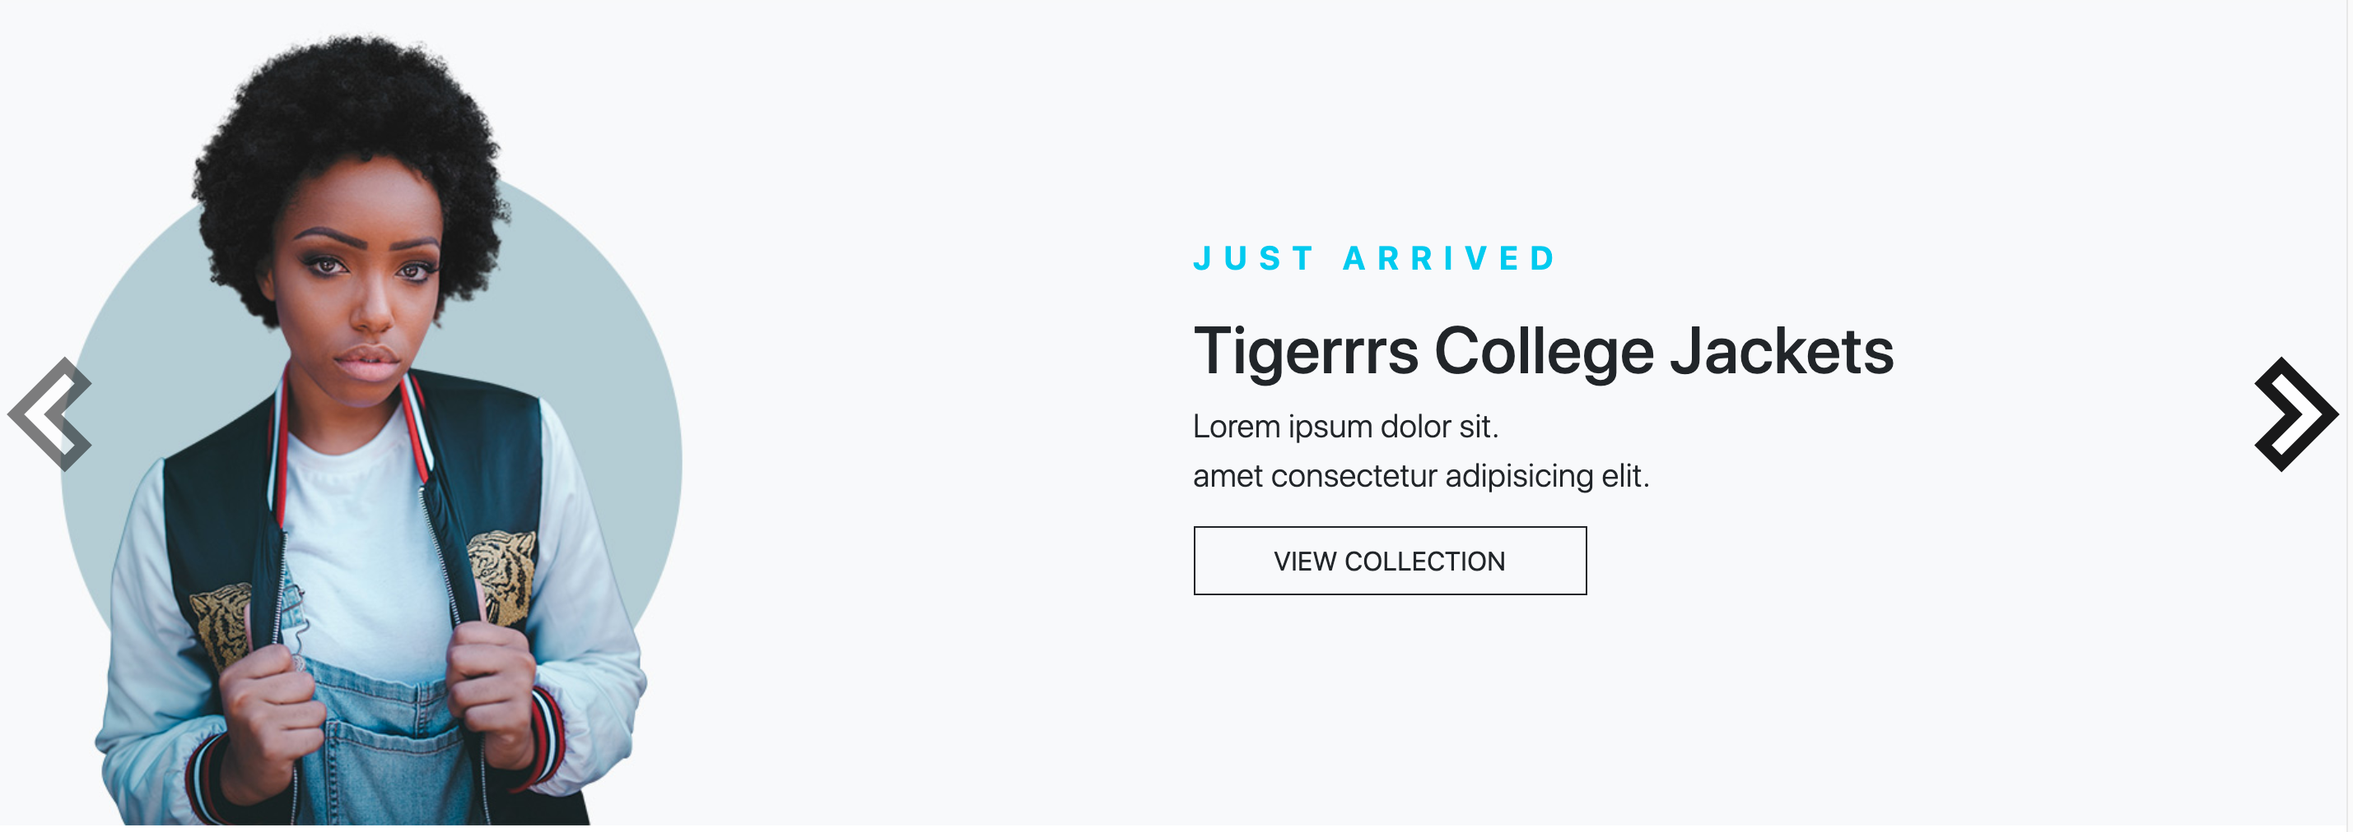
Carousel

Slide 9
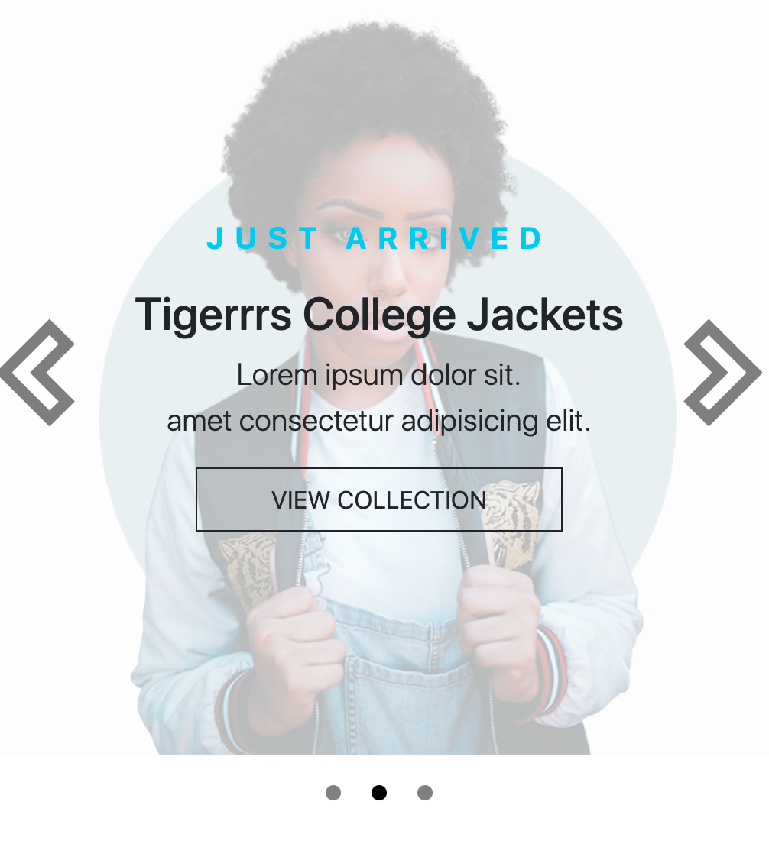
Carousel

Slide 10
Carousel
We will add custom carousel controllers icons
The image we can see is a background with background-position: center right\left;
We control the position of the text with row, justify-content and col-md-6
We can see indicators in the small screen. We will give the indicators d-md-none text-center, position: absolute; top: 102%;
$carousel-indicator-active-bg: black;
$carousel-indicator-height: 10px;
$carousel-indicator-width: 10px;
$carousel-indicator-spacer: 10px;

Slide 11
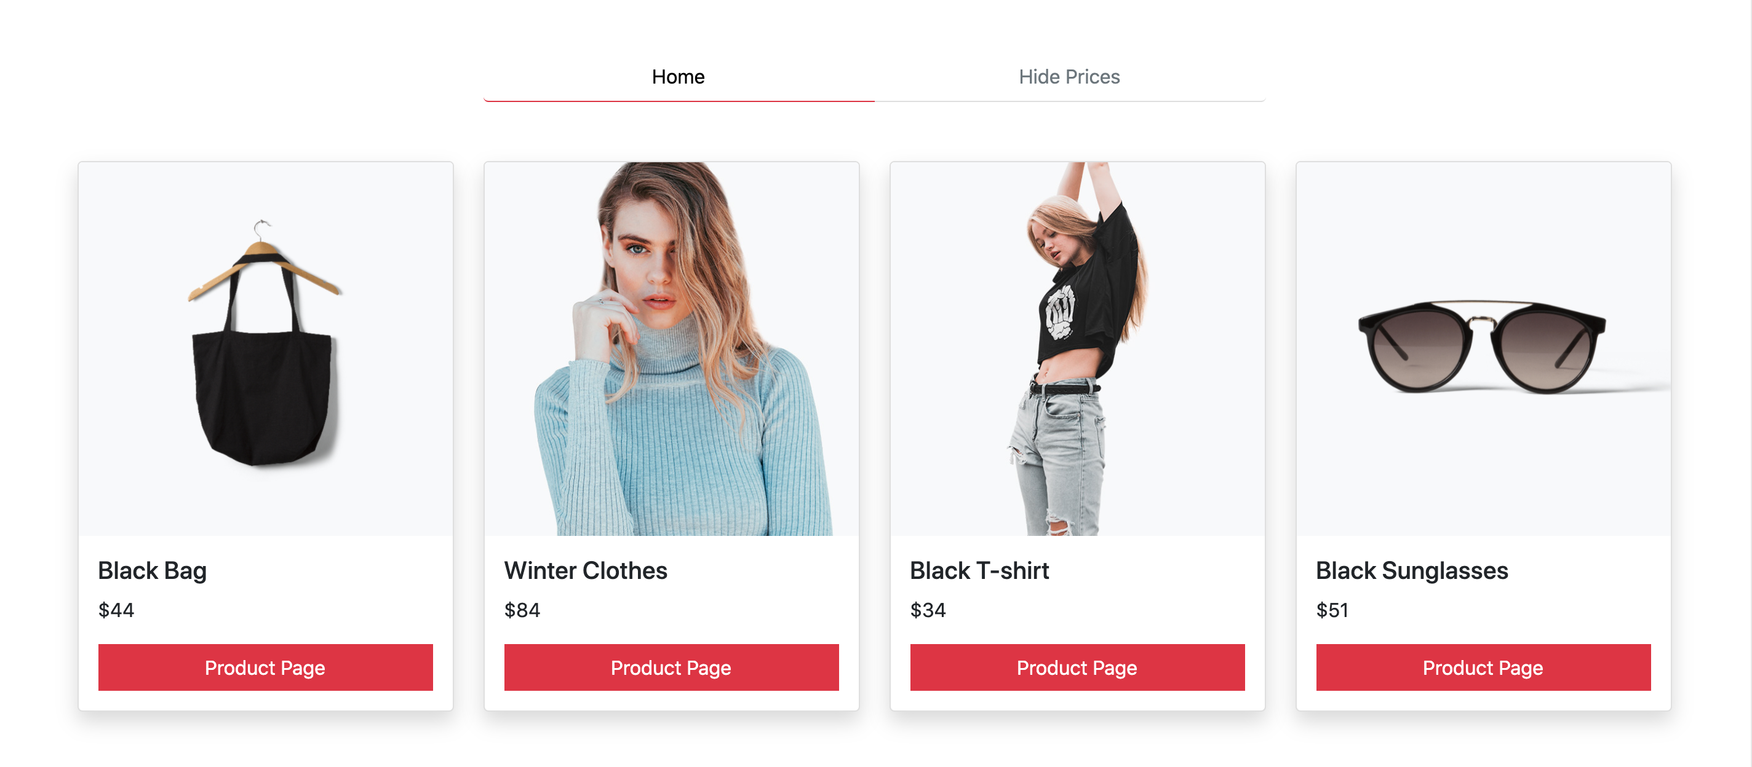
Products

Slide 12
Products
We will add section, container, with paddings.
Then, row justify-content-center and col-md-6 for list-group-item
We will add three columns of the same content for the version in the videos
<div class="col-md-3 col-6 mb-md-0 mb-4"> with card, content and stretched-link
For hidden price: <h5 class="card-title">Winter Clothes</h5> will be: <h5 class="card-title placeholder">Winter clothes</h5>
Just add placeholder class and remove the fade class from the effect.
We will edit some Styles for the list group to be:
$list-group-active-bg: transparent;
$list-group-active-border-color: var(--bs-danger);
$list-group-active-color: black;
$list-group-color: #6c757d;

Slide 13
Products
We will give .list-group-item {
border: none;
border-bottom: 1px solid rgba(0, 0, 0, 0.125); }
To just keep the border bottom

Slide 14
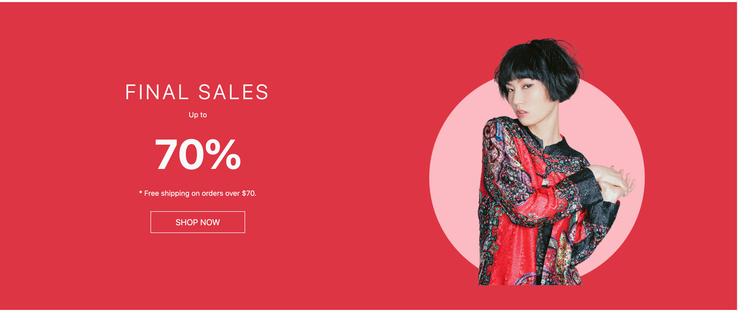
Final sale

Slide 15
Final sale
We use section with bg-danger and my-5, container, row with py-5 align-items-center and two col-md-6
The first column:
class="fs-1 fw-light" style="letter-spacing: 5px;” for the header “Final Sale”
Small for up to
display-1 fw-bolder my-3 for the 70%
<small class="mb-5">* Free shipping on orders over $70.</small>
btn btn-outline-light text-uppercase mt-4 px-5 py-2 rounded-0 for shop now.
The second column will contain the image

Slide 16
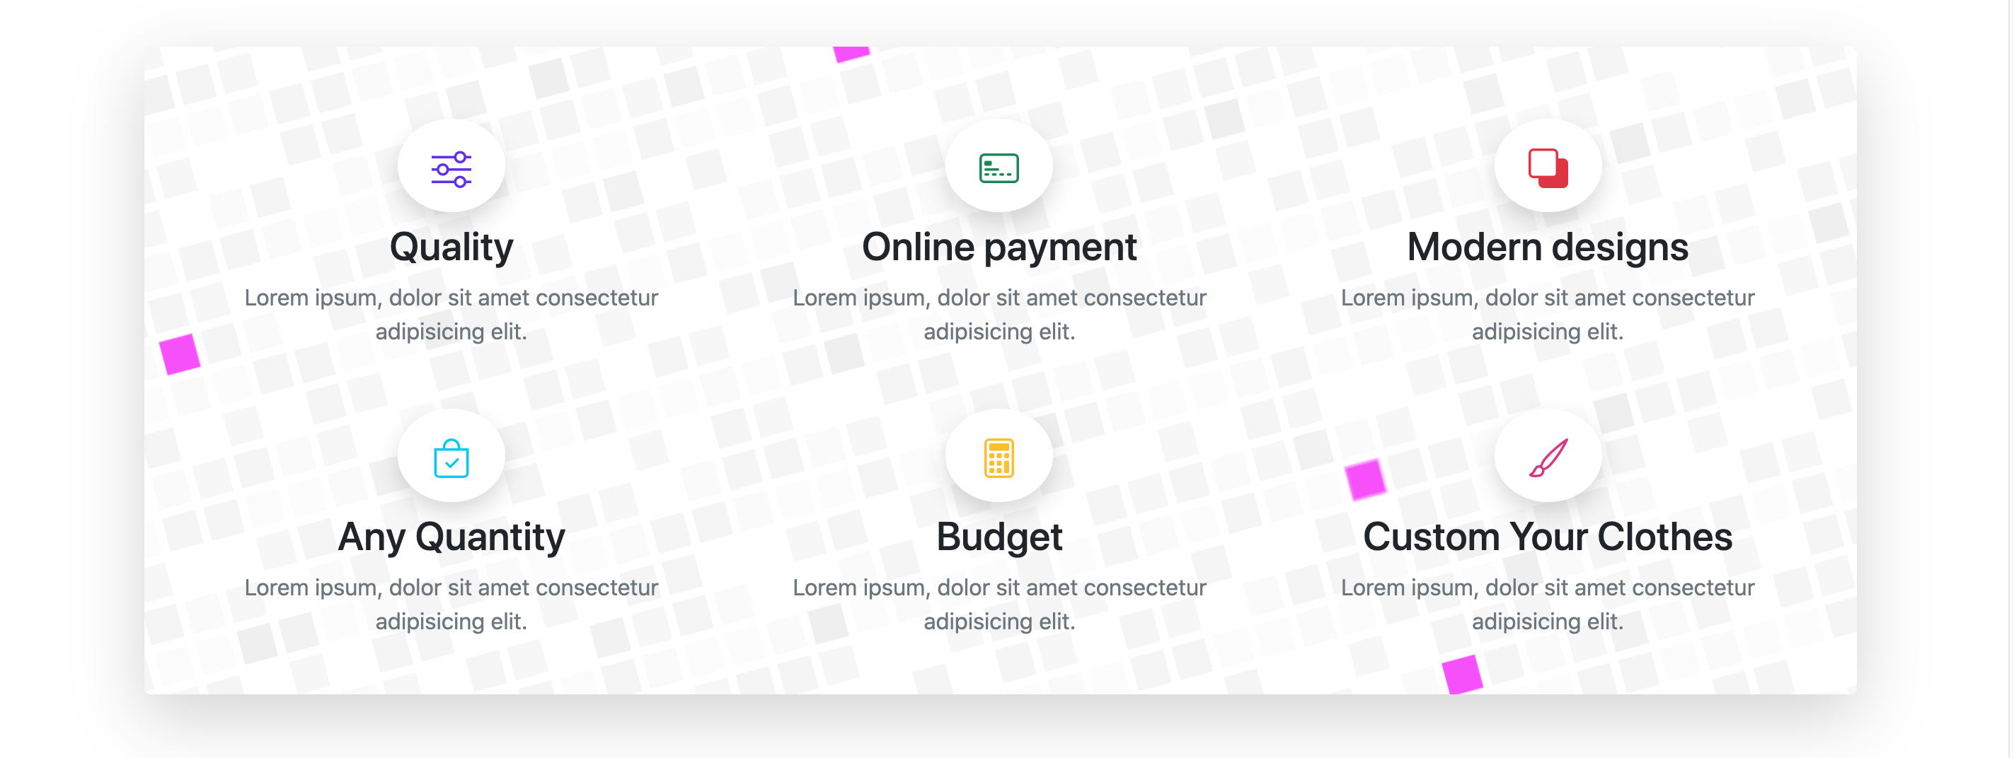
Why section

Slide 17
Why section
We use section, container with text-center, row with justify-content-center, col-11 a new grid system inside with row p-4 align-items-center and 3 col-md-4 col-6.
<span class="rounded-circle p-4 bg-white shadow">SVG</span> for the svg

Slide 18
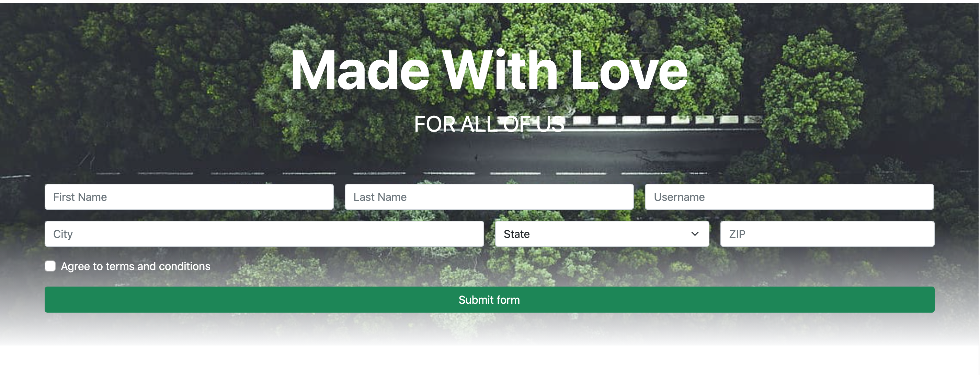
Contact form

Slide 19
Contact form
For the contact form: we use section, container, text-center for the header and finally row with the validate form from: https://getbootstrap.com/docs/5.1/forms/validation/#custom-styles with Some Sass
$form-feedback-valid-color: blue;
$form-feedback-invalid-color: red;

Slide 20
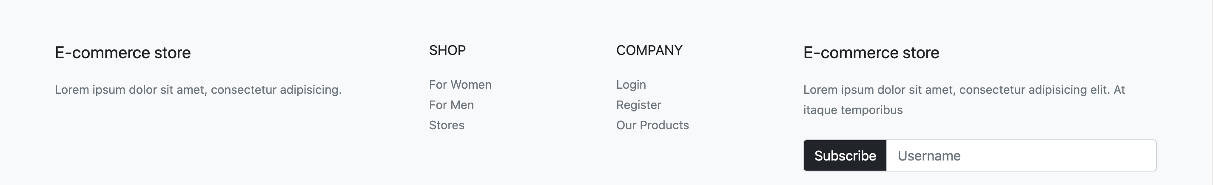
Footer

Slide 21
Footer
We use footer with bg-light, container, row, col-md-4 for the first row, col-md-2 for two middle rows and col-md-4 for the last row
We will edit the Sass of input group to be:
$input-group-addon-color: black;
$input-group-addon-bg: transparent;

Slide 22
Copyright

Slide 23
Copyright
It will be inside the footer.
We can use bg-dark with py-5, container with d-flex flex-md-row flex-column text-white justify-content-between.
The first div element for the copyright
The second div element has class: d-flex to make the images flexible

